Slide 1
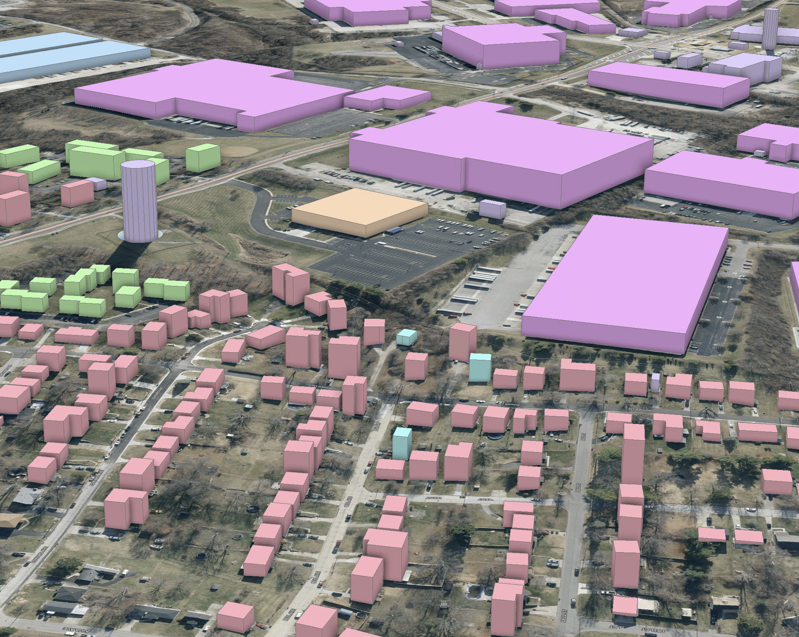

KyFromAbove
Ian Horn
ian.horn@ky.gov
A fun talk about STAC
Notes:
I used the word fun in my title because last year my talk might have been on the technical side. This year, I want to keep it more on the user experience and how we can do great things with KyFromAbove data.

Slide 2

Notes:
Today, I want to talk to you all about how we can take advantage KyFromAbove in the cloud
Notice that the proportion of blue to red is very representative of the state regarding cats and cards.

Slide 3


Review
Last year - focused on the WHAT, WHERE, WHY of KyFromAbove in the cloud.
This year – I want to talk about the HOW of
KyFromAbove in the cloud.
Notes:
Last year what really about the what does KyFromAbove mean, where is it. This year, it’s more about how can we use.

Slide 4
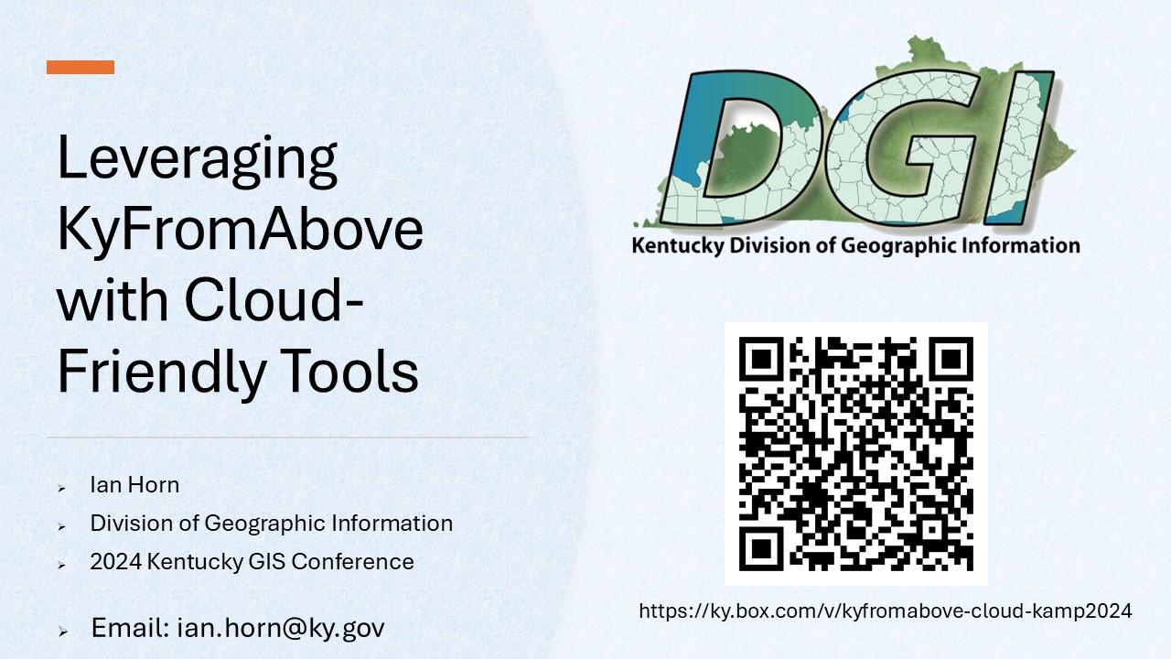
Last year’s talk
I placed a link in the year’s Sched presentation page.

Slide 5



This Year
Last Year

Slide 6
But first, back to the Why?
<Insert Head Exploding Meme>
Humor is fun!
<Insert Funny Cat Gif>
Notes:
Why do we care about STAC . Who benefits from it, and the answer is you do. We want to make it easier for you to attain.

Slide 7
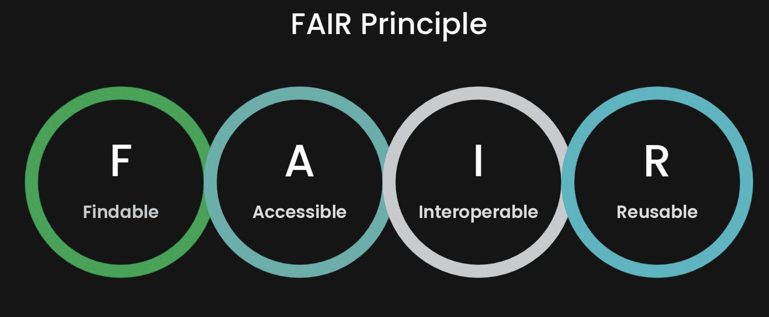
Notes:
Because it’s fair. This is a concept I’ve heard a lot over the last couple year or two and it’s something we here at DGI strive for. We have to ask ourselves, is it FAIR? Is it Findable, Accessible, Interopable, and Reusable?

Slide 8
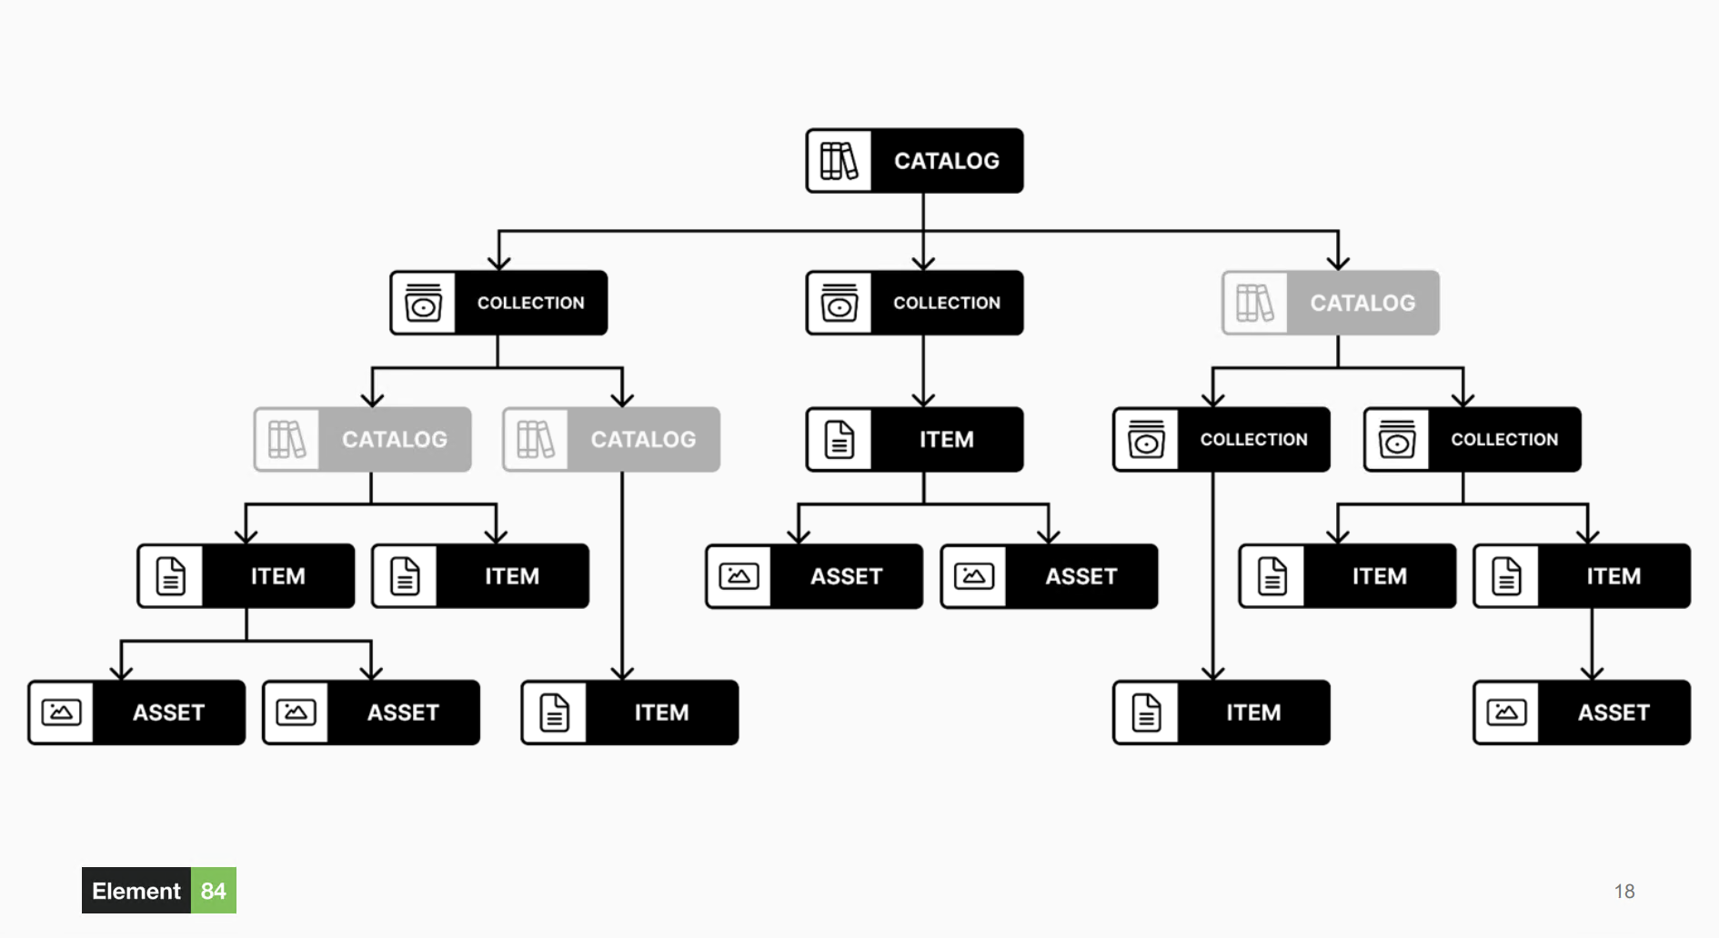
STAC - Background

Slide 9
SpatioTemporal Asset Catalog
The STAC specification provides a common structure for describing and cataloging spatiotemporal assets.
- stacspec.org

Slide 10

STAC Fundamentals
Last Year’s Slide
STAC Item – core atomic unit
STAC Catalog – parent, simple and flexible, structure to organize and browse STAC Items
STAC Collection – extension of the Catalog, provides additional information (extents, license, keywords, etc.)
STAC API - provides a RESTful endpoint that enables search of STAC Items, specified in OpenAPI, following OGC's WFS 3.
https://stacspec.org/en
Notes:
The STAC Specification consists of 4 semi-independent specifications. Each can be used alone, but they work best in concert with one another.

Slide 11

What’s next?
Still Last Year
APPEND Static Catalog with new deliverables
Static catalog → API
What does this mean?
Find an API and just add our data as a collections
Stactools-packages, stactools pipelines
Other Federation Options – “One STAC to rule them all”
Get involved
We made it Open, help make it discoverable!

Slide 12


Slide 13



Slide 14
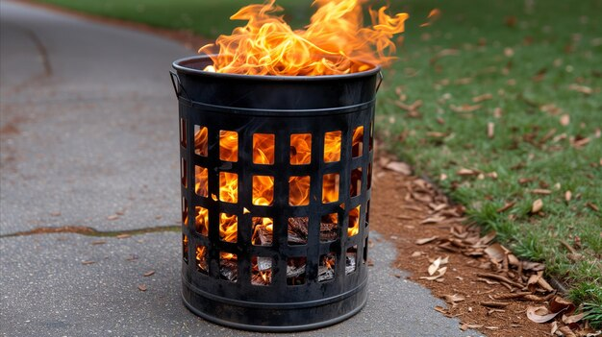

Static Catalogue

Slide 15
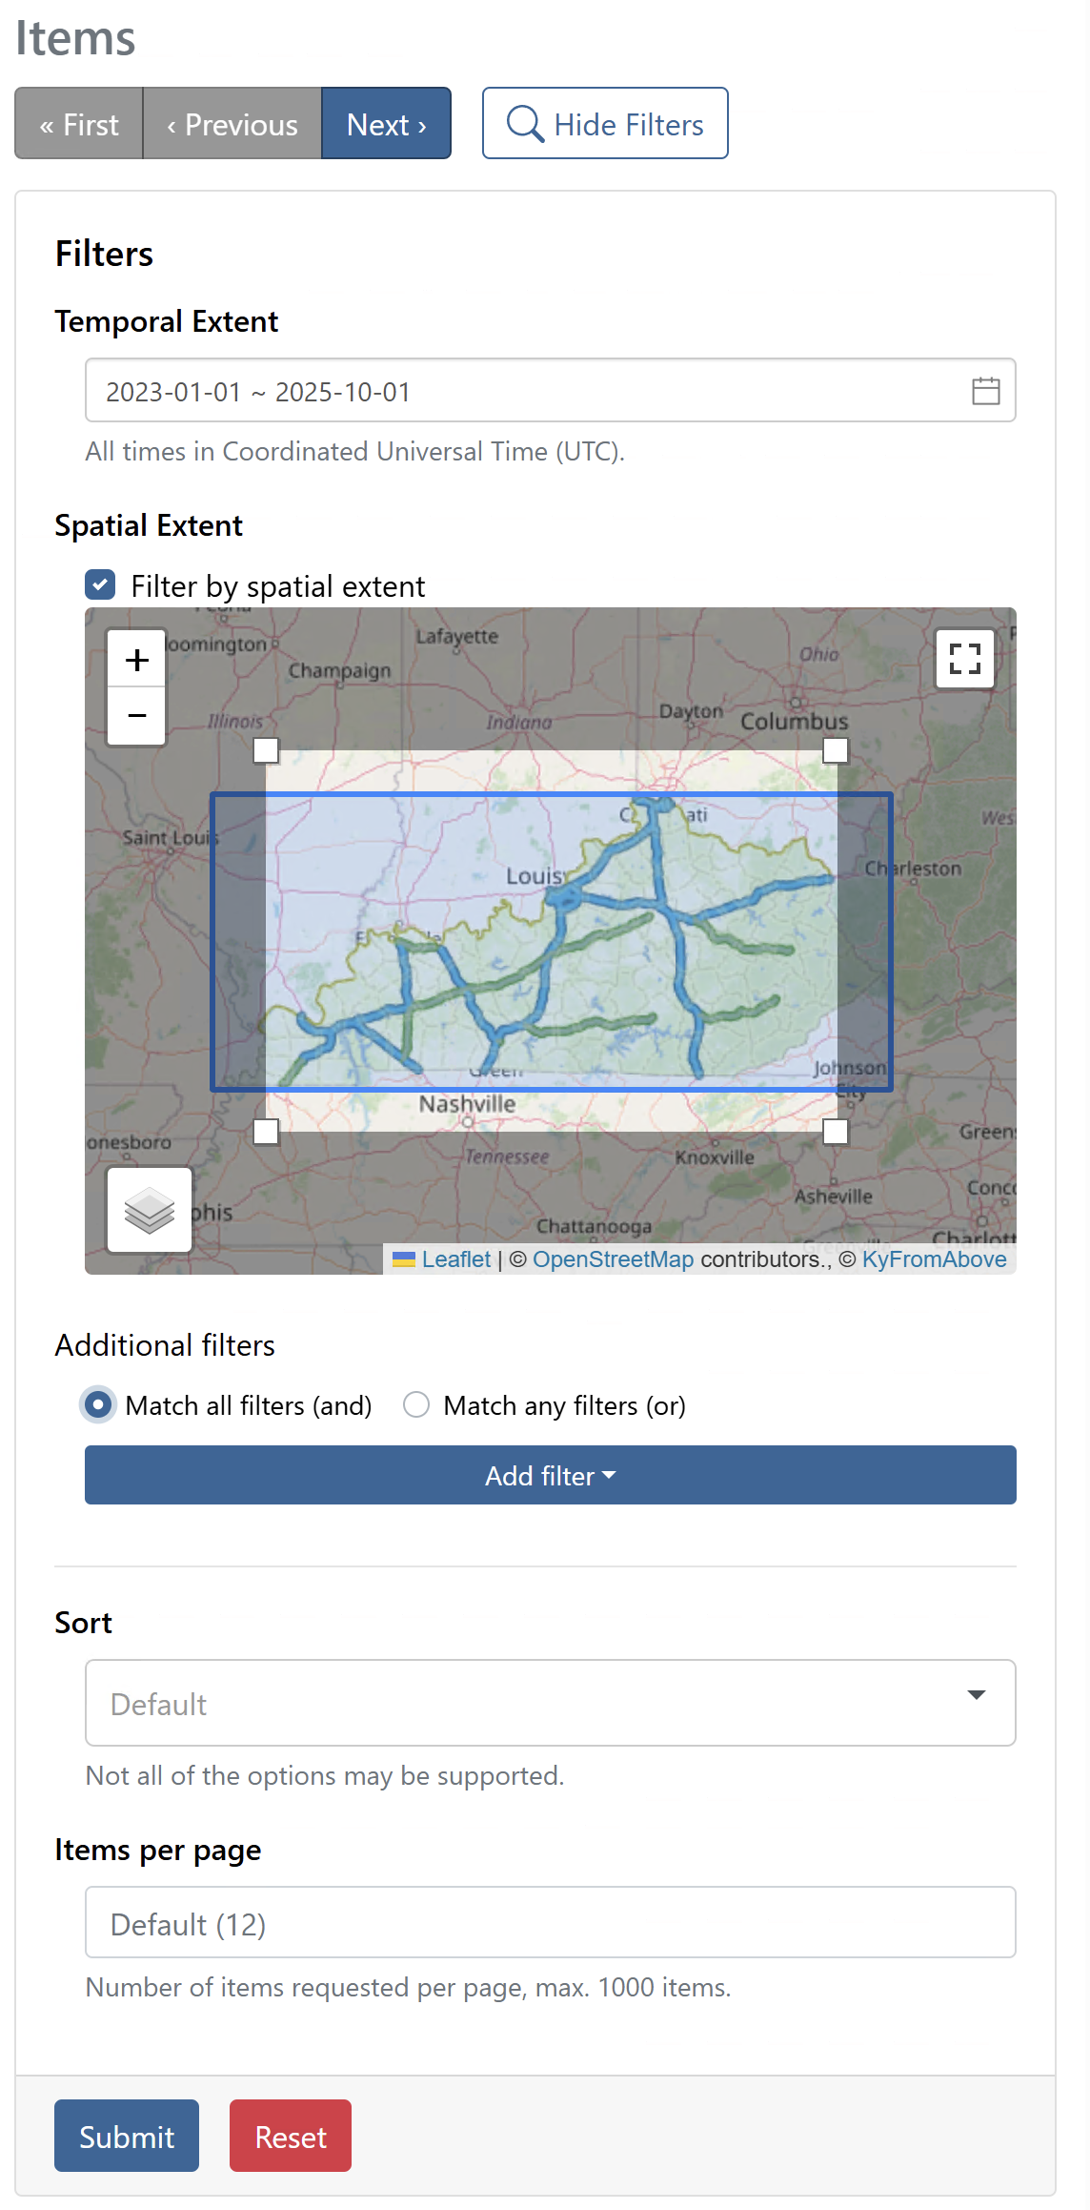
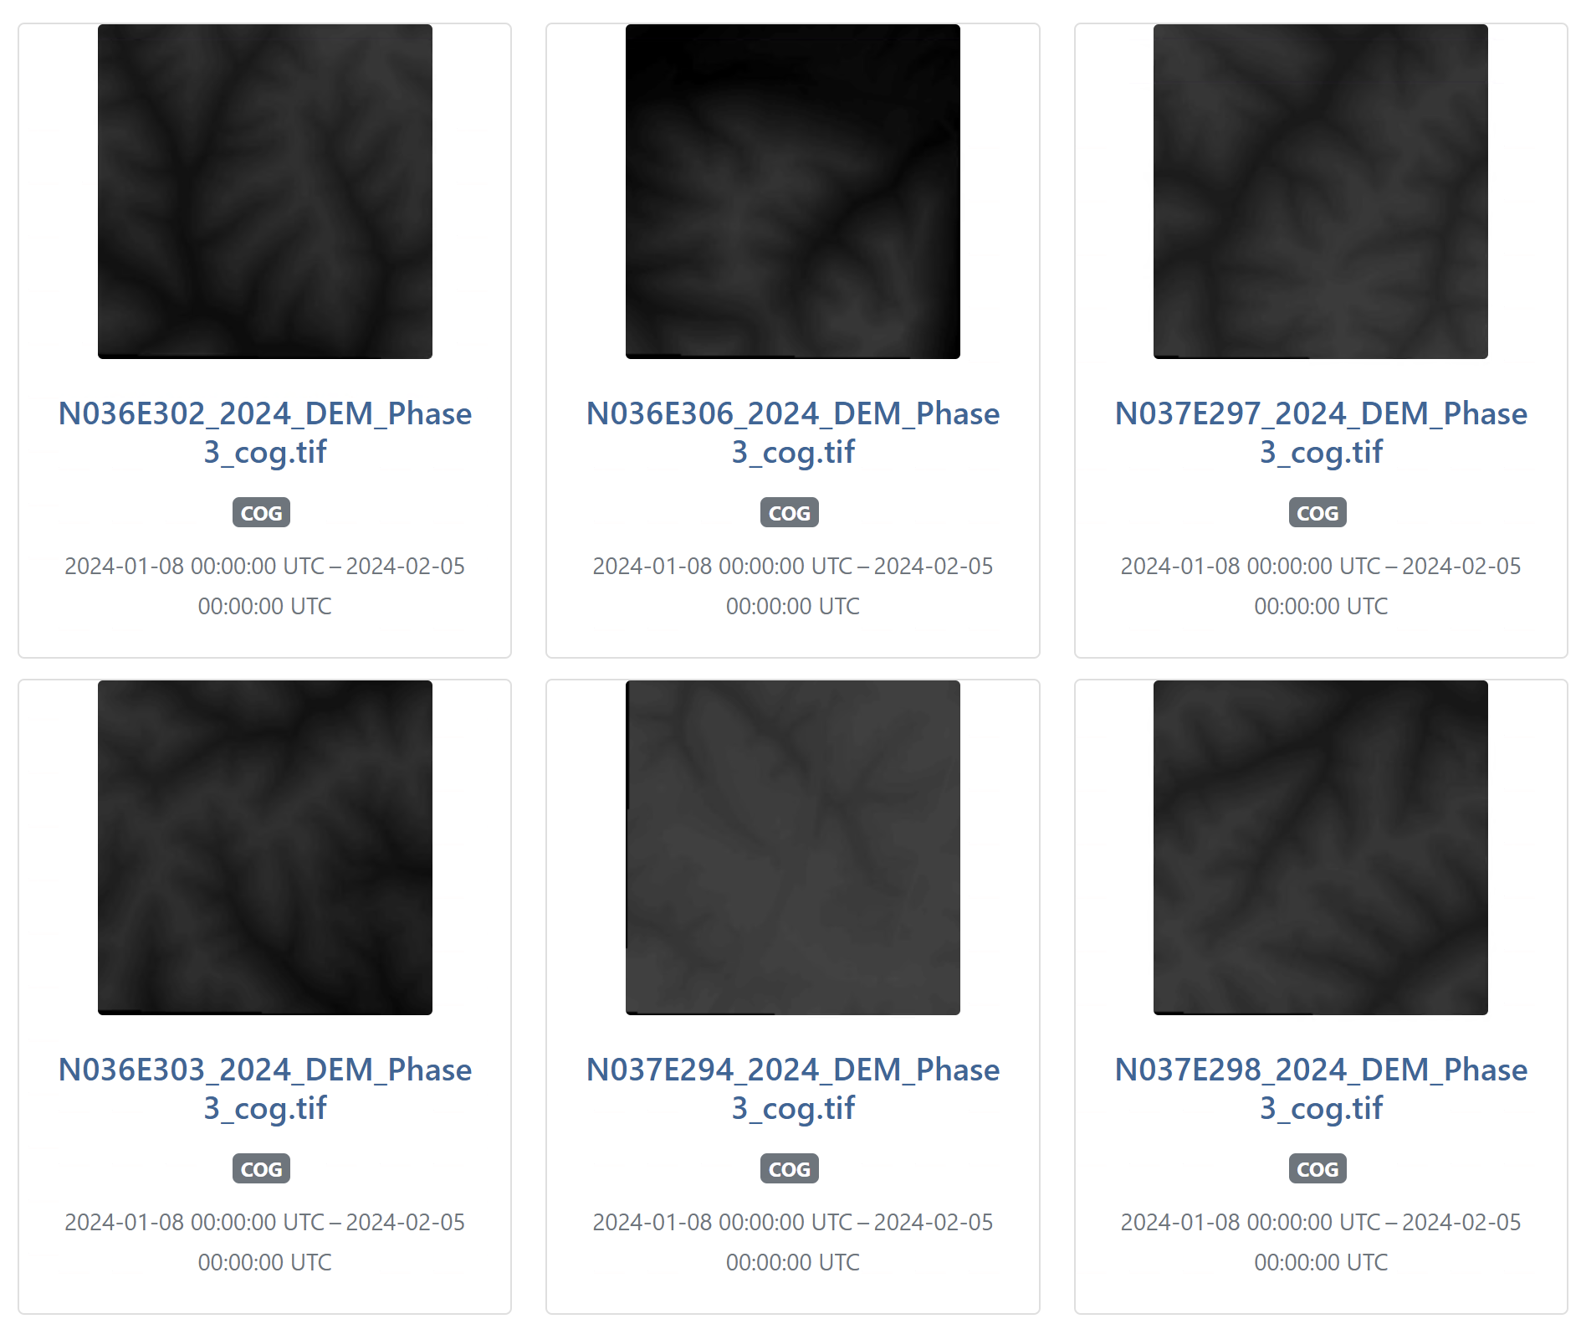
STAC API
The static STAC allows users to browse while the dynamic STAC API enables automated querying and retrieval of the data. – PGC
Static

Slide 16
How can I use the STAC?

